Slide 1
MATLAB SIMULINK

Slide 2
A Tool for System Simulation: SIMULINK
Can be used for simulation of various systems:
  Linear, nonlinear;
Input signals can be arbitrarily generated:
  Standard: sinusoidal, polynomial, square, impulse
  Customized: from a function, look-up table
Output signals can be stored or demonstrated in
different ways.

Slide 3
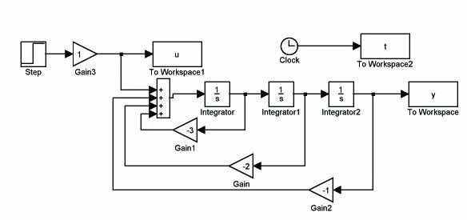






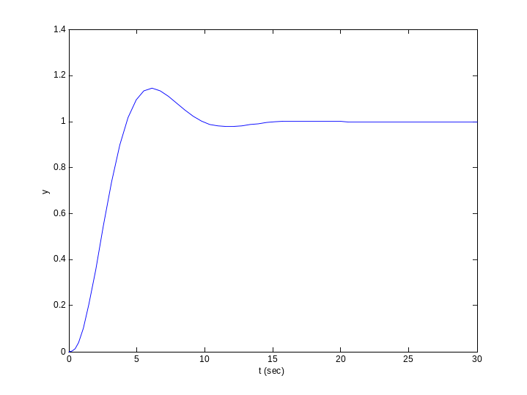
Example:
Input u
Click simulation and use plot(t,y),
you will get a time response of y
The parameters can be easily changed;
The initial condition can be easily changed.

Slide 4


The components:
Main components with dynamics:
  integrators,
  transfer function
  zero-pole description
The first one needs an initial condition.
It can be assigned by clicking on the
component
Math components:
  gain (amplifier) kx : x a scalar
  addition (a+b+c); product (a×b); you can
  change the number of terms and the sign
  of each term

Slide 5

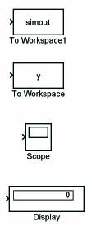
Sources: input signals
  constant, step, ramp
  pulse, sine wave, square wave
  from data file
  signal generator
  The clock to record time
Sinks: for output demonstration or storage
  export to workspace; you can give a name
  to the variable, such as u, y, x, etc.
  scope
  digital display

Slide 6
Example: Find the solution to the systems
where y(0)=0; y’(0)=0. u(t) is a square wave.
Steps:
Open matlab workspace
type simulink and return
- simulink library browser window is open
Click file and choose new then choose model
- a blank window is open
Open one of the commonly used blocks and drag and drop
whatever you need to the blank window.
5. Connect the components by arrows.

Slide 7
Click each component to setup the parameters properly
sinks labeled “t”, “u”, “y”: choose “array” for save format
sampling time can be a parameter inputted from workspace
they can be chosen as -1 for inherited
When ready, click simulation and choose configuration parameters
to setup simulation time. Finally, click simulation and choose start
When finished, type plot(t,y,t,u) to plot the input and output

Slide 8


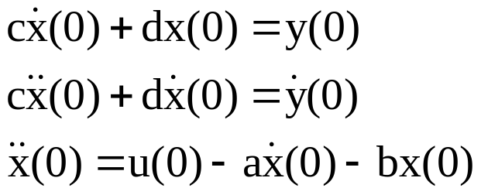


How to realize
Can we first get
and then realize
Theoretically, we need future information of u(t), t > t₀ to get
the derivative at t₀. This cannot be realized.
We may only use the past information to get an approximation.
But still it is better not to use differentiator. If a signal is
contaminated by noises, taking derivative will magnify the noises.
One approach to avoid differentiation is as follows:
- First realize
Initial condition
determined from
Then set
- You can verify that y satisfies (*).

Slide 9







